Slide 1
The Future of Alcatraz Diagnostics
ADS v1.0
By Sumeet Bansal, Pierce Kelaita, and Gagan Gupta

Slide 2

Goals and Overview
Alcatraz Diagnostic Suite
What is ADS?
Why create ADS?
How is ADS helpful?
Is ADS scalable?
to facilitate multi-team coordination
QA won’t have to find differences at runtime
yes, across many different file types and environments

Slide 3







Architecture and Pipeline
Currently under development
UI
Database
Query
Comparator
File Parser
CSV Report
Servers

Slide 4
Directory Generation
directly accesses dev VMs
populates user-specified directories
Jar Arguments:
~$ zk generate <host IP> <root directory> <environment name> [exceptions]
~$ zk generate 127.0.0.1 C:/Users/sbansal/Desktop jeremy blacklist

Slide 5
File Parser
extensible program design
supports a variety of data formats
example unparsed property:
dr/ceph/url=cxf/actiance/apc/dr/drceph/processEvents
same property as parsed database entry:
“key” : “dr/ceph/url”,
“value” : “cxf/actiance/apc/dr/drceph/processEvents”,
“environment” : “chris”,
“fabric” : “storm”,
“node” : “common”,
“filename” : “server.properties”

Slide 6


Database Editor
independently operable and modifiable
user-friendly commands
flexible schema
Jar Arguments:
~$ db info
~$ db clear
~$ db populate C:/example_directory

Slide 7
ADS Advanced Query
flexible parameters for precise queries
wildcards
exclusions (under development)
generates detailed diagnostic reports
Jar Arguments:
~$ query compare <query 1 left> <query 1 right>
~$ query compare steve praneeth
~$ query compare steve/storm praneeth/storm
~$ query compare steve/storm/common/ praneeth/storm/common
~$ query compare steve/*/common praneeth/*/common
~$ query compare steve/storm/node1 steve/storm/node2

Slide 8

ADS Abstract Parser Design
currently supported file types
.properties / .prop
.yaml / .yml
.config / .conf / .cfg
hosts
designed to allow for extensibility

Slide 9

Future Updates
Planned v2 updates:
XML parser
more advanced query searches
more options for database modification
configurable CSV reports
Further planned updates:
watchers to auto update database
UI (under development)

Slide 10
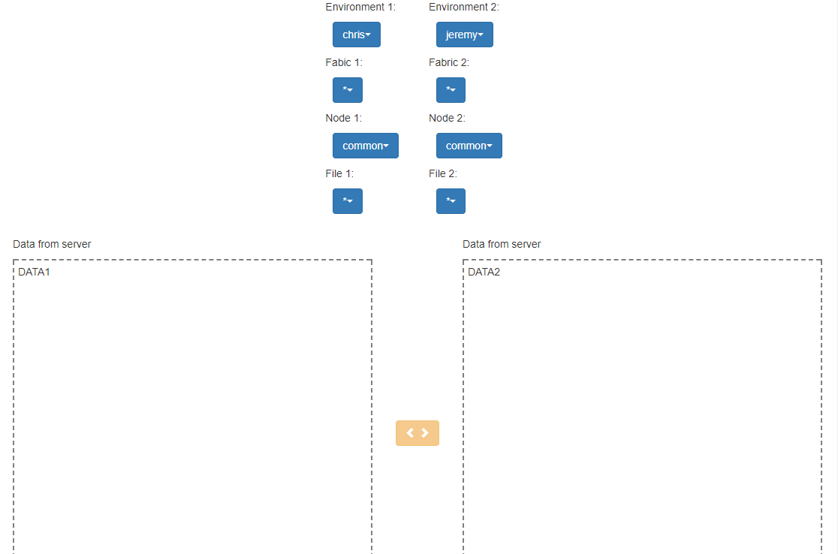
Projected UI

Slide 11
Questions? Comments? Concerns?
Thank You!

